Slide 1

COM3123 - Lecture 6
Angular Services & Observables

Slide 2
Topics
Template Forms
Angular Services
RxJS
Obsevables

Slide 3
Angular Forms

Slide 4
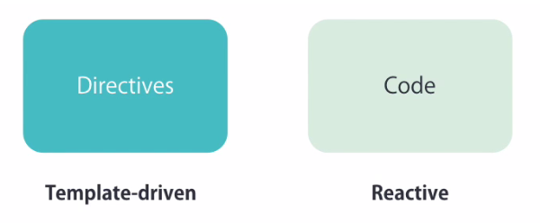
Types of Angular Forms

Slide 5
Reactive vs Template Driven Forms
Reactive
More control over validation logic
Good for complex forms
Unit testable
Template Driven
Good for simple forms
Simple validation
Easier to create
Less code

Slide 6
Template Driven Forms

Slide 7
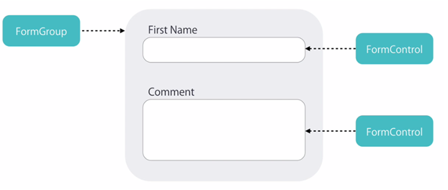
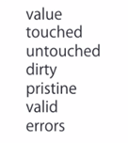
Form Validation
Adding Template Driven Form directives Angular will create the FormControls and FormGroups to allow for validation

Slide 8
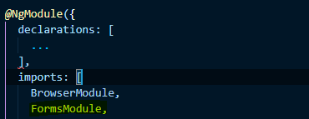
FormsModule
FormsModule exports the required providers and directives for template-driven forms
There are two changes to app.module.ts
Import FormsModule
Add the FormsModule to the list of imports defined in the @NgModule decorator
https://angular.io/api/forms/FormsModule

Slide 9
NgForm Directive
Angular automatically creates and attaches an NgForm directive to the <form> tag.
The NgForm directive supplements the form element with additional features.
It holds the controls you created for the elements with an ngModel directive and name attribute.
It also has its own valid property which is true only if every contained control is valid. https://angular.io/guide/forms#ngForm

Slide 10
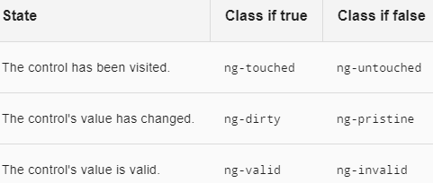
NgModel to track control state
NgModel in a form gives you more than just two-way data binding. It also tells you if the user touched the control, if the value changed, or if the value became invalid.
The NgModel directive doesn't just track state; it updates the control with special Angular CSS classes that reflect the state. >> validation

Slide 11

Template Reference Variables
Template reference variable or "hashtag syntax" is quick way to create a reference to an element in the HTML element
The variable will have all properties of the HTMLElement ie. ID, name, innerHTML, value etc.
Nice way to avoid using ngModel, in a simple form without complex validation

Slide 12
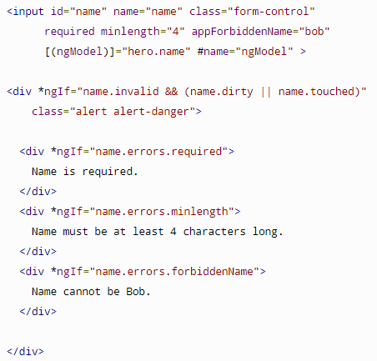
Template Driven Validation
To add validation to a template-driven form, you add the same validation attributes as you would with native HTML form validation. (required, min, max, etc..)
Angular uses directives to match these attributes with validator functions in the framework.
Every time the value of a form control changes, Angular runs validation and generates either a list of validation errors

Slide 13
Services

Slide 14
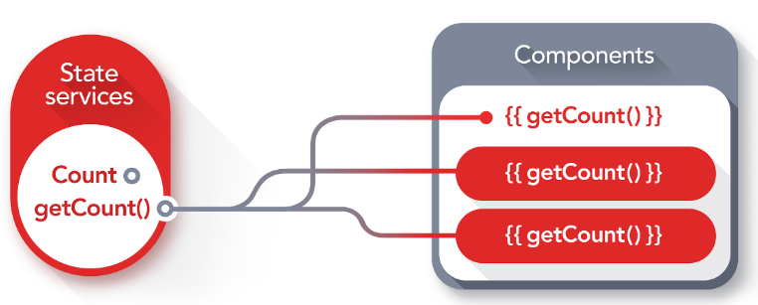
Angular Services
Services allow for greater separation of concerns for your application
Service are singletons that carry out specific tasks (* when registered in AppModule)
Better modularity by allowing you to extract common functionality out of component
Dependency Injection to allow components to access the service across application
Components should delegate tasks to the service ie. fetching data.

Slide 15

Dependency Injection
Dependency Injection is when one object supplies the dependencies of another object.
A dependency is an object that can be used (ie. a service)
An injection is the passing of a dependency to a dependent object (a client) that would use it.
https://angular.io/guide/dependency-injection
SOLID principles/Inversion of Control
Promotes Loose Coupling
DIC Containers ie. AutoFac, NinJect

Slide 16
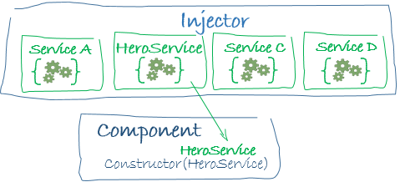
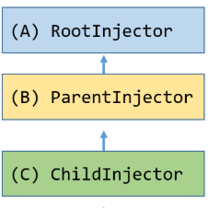
Angular Injector
Angular comes with it’s own dependency injection framework for resolving dependencies.
The Angular dependency injection system is hierarchical. There is a tree of injectors that parallel an app's component tree. You can reconfigure the injectors at any level of that component tree. (Angular 1.x => flat tree)
CLI Optimization tools can perform “tree shaking” to remove dependencies that are not used. This results is smaller bundle sizes

Slide 17
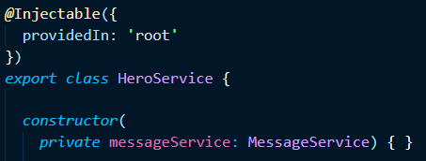
@Injectable Decorator
The @Injectable decorator is needed when a Service needs dependencies injected to its constructor.
Injectable() is optional, but common practice is to add the decorator for all services for consistency and so that when a service requires dependencies in the future you don't have to worry about adding it.
Angular CLI Command > ng generate service servicename

Slide 18
Retrieving Data Using HTTP

Slide 19
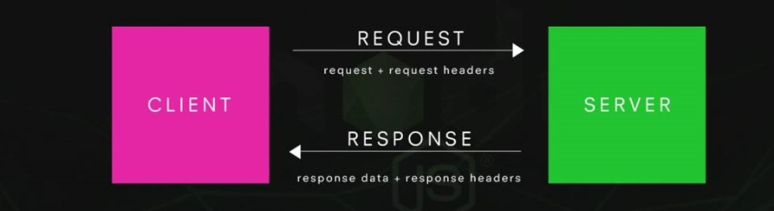
Sending an HTTP Request

Slide 20
Angular HTTP Service
HTTP service is available as an injectable class, with methods to perform http requests.
Calling requests returns an Observable which will emit a single Response when a response is received
Just like Angular 1.x, it's recommended that Http calls are wrapped within services instead of being used in Components directly.
- This allow for greater flexibility in you application structure
Notes:
This allows for greater flexibility in your application structure.

Slide 21
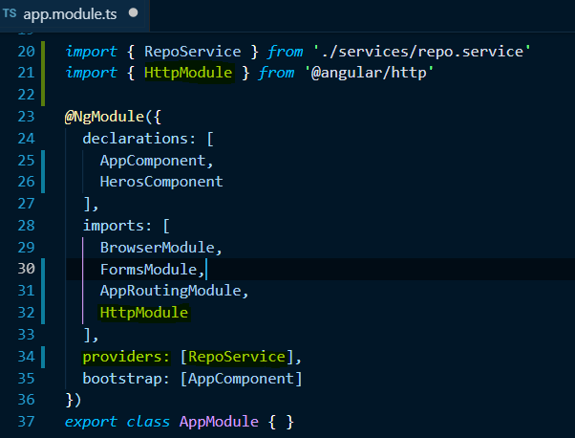
Registering Service in App.Module
Register the HTTP service in the AppModule to be used throughout the app
Import HttpModule from @angular/http, which contains all provider we need to make requests
* It is recommended that Http calls are wrapped within services instead of being used directly in Components. (flexibility, testing)

Slide 22
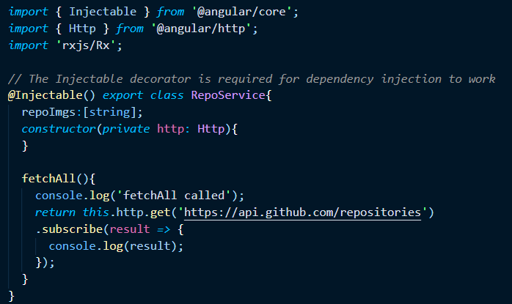
Sending an HTTP GET Request

Slide 23

Single Responsibility Principle
A class should have only one responsibility
Separation of Concerns - class should do one specific concern and do it well.
For example, a Component should deal with UI logic, and a Service should provide data.

Slide 24
RxJs & Observables

Slide 25

What is RxJS?
RxJs is a javascript library that brings concept of "reactive programming" to the web.
Reactive programming is programming with asynchronous data streams..
We "react" to changes that happen (click event, data fetched) instead of writing code to handle those changes ("imperative" programming).
Similar concepts found in Node.js Streams!
https://angular.io/guide/rx-library

Slide 26
Why RxJs?
Asynchronous event streams, ie. click events on which you can observe and do some side effect is not new.
RxJS can be thought of as writing assembly lines in your software applications. It allows you to write software that is reusable, configurable and asynchronous.
Possibilities are endless. Assembly lines (ie. RxJS Observables) can be chained together, split apart, configured different, or used without any modification at all

Slide 27
Observer Design Pattern

Slide 28
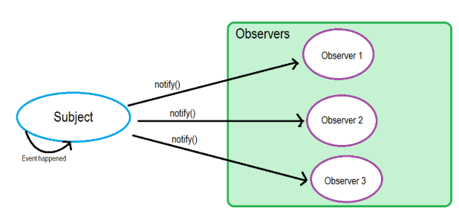
Observer Pattern
The observer pattern is a software design pattern in which an object, called the subject, maintains a list of its dependents, called observers, and notifies them automatically of any state changes, usually by calling one of their methods.

Slide 29
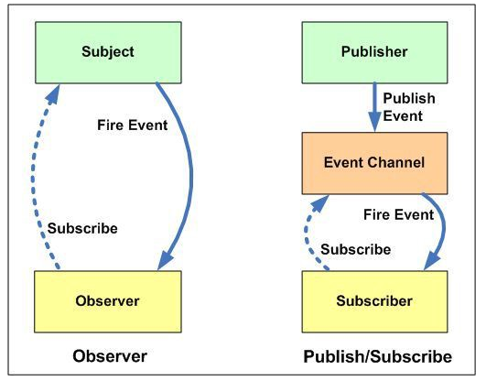
Observer vs Publisher/Subscriber
In the Observer pattern, the Observers are aware of the Subject, also the Subject maintains a record of the Observers. (synchronous)
In Publisher/Subscriber, publishers and subscribers don’t need to know each other. They simply communicate with the help of message queues or broker (Event Bus)
(asynchronous)

Slide 30
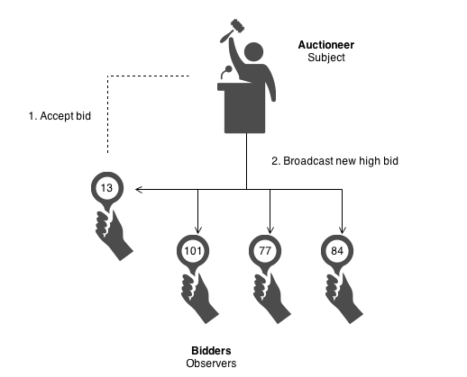
Observer Pattern Example
The auctioneer starts the bidding, and "observes" when a paddle is raised to accept the bid.
The acceptance of the bid changes the bid price which is broadcast to all of the bidders in the form of a new bid.

Slide 31
Observables, Observers and Subscriptions

Slide 32
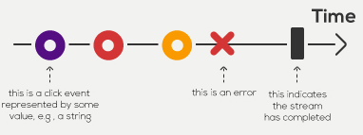
Observers and Observables
Observers allow you to push new data into an observable sequence.
It is "write-only" ie. observer can only add new cars onto an assembly line
An Observable is what we use to listen to, aka subscribe, to new changes that are emitted by an Observer.
It is a "Read-only" assembly line (you can only observe when new cars come off the assembly line)

Slide 33
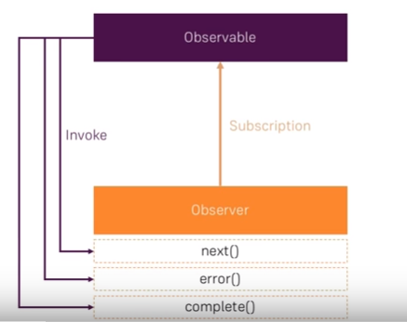
Observables, Observers and Subscriptions
The Observable is a wrapper around the stream of values
The Subscription is a way to tell the Observable that someone is listening to these values
The Observer invokes three methods next(), error() and complete()
next() is called by Observer, when new value is emitted

Slide 34
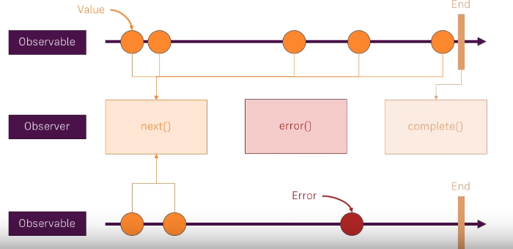
Observable Stream

Slide 35
Promise vs Observable
Promise
Provides a single future value
Not lazy
Not cancellable
Observable
Emits multiple values over time
Lazy
Cancellable
Supports map, filter, reduce and similar operators

Slide 36
Observables Operators

Slide 37
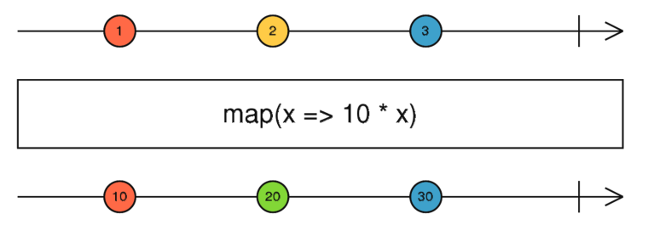
Observable Operators
Methods on observables that compose new observables
Transform the source observable in some way
Process each value as it is emitted
Examples, map, filter, take, merge
Map operator allows use to transform the incoming data as it receives it.
http://rxmarbles.com/#map

Slide 38
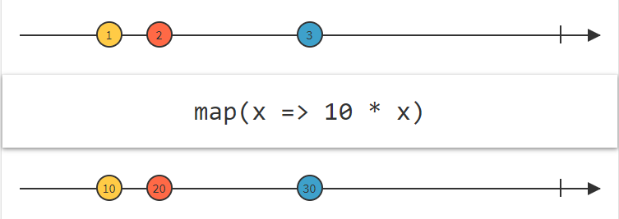
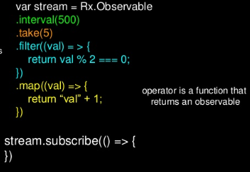
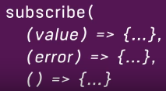
Observable Operators cont..
Operators allow you to perform operations on your code
Operators are methods on the Observable type, such as .map(...), .filter(...), .merge(...), etc. https://www.learnrxjs.io/operators/
An Operator is a function which creates a new Observable based on the current Observable. The previous Observable stays unmodified.
subscribe() method takes a list of function or object that implements those methods.

Slide 39
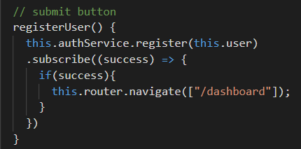
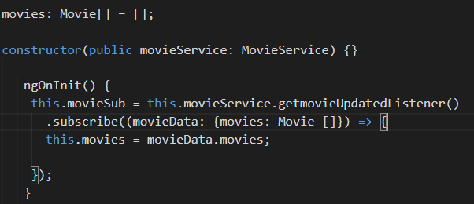
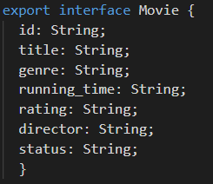
Project Code Examples..
Connecting the back end data server objects from an API will require mapping the observable data to a typescript UI model!

